Slide 1
Probability review
Miss L
Year 9

Slide 2
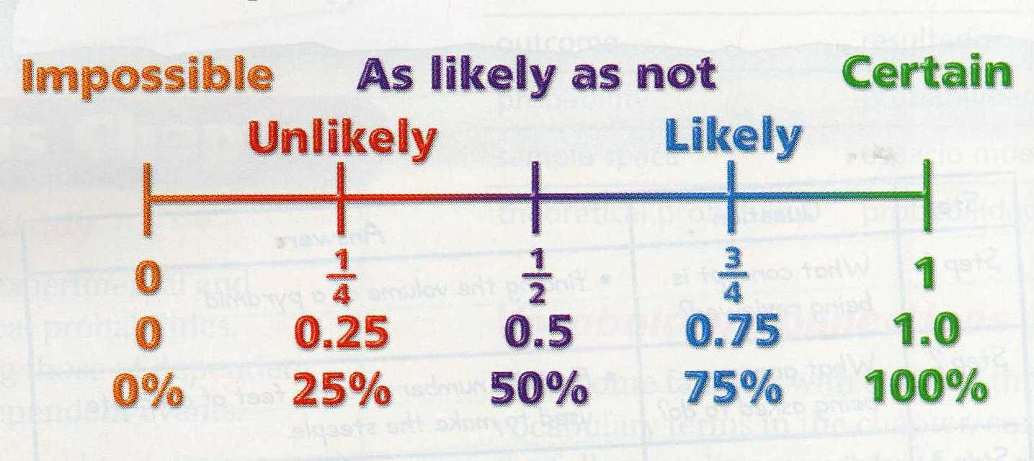
24
7
30
Topic: Probability
Date:
EQ – What have we learnt about probability so far?
Probability: is the likelihood that an event will occur.
Probability can be written as a fraction or decimal.
What is probability?
_______________
_______________
_______________

Slide 3
24
7
30
Topic: Probability
Date:
EQ – What have we learnt about probability so far?
Probability is always between 0 and 1.
Probability = 0 means that the event will NEVER happen.
Example: The probability that the Perth Wildcats will win the AFL Grand Final this year.
Probability = 1 means the event will ALWAYS happen.
Example: The probability that Christmas will be on December 25th next year.
What is probability?

Slide 4


Slide 5
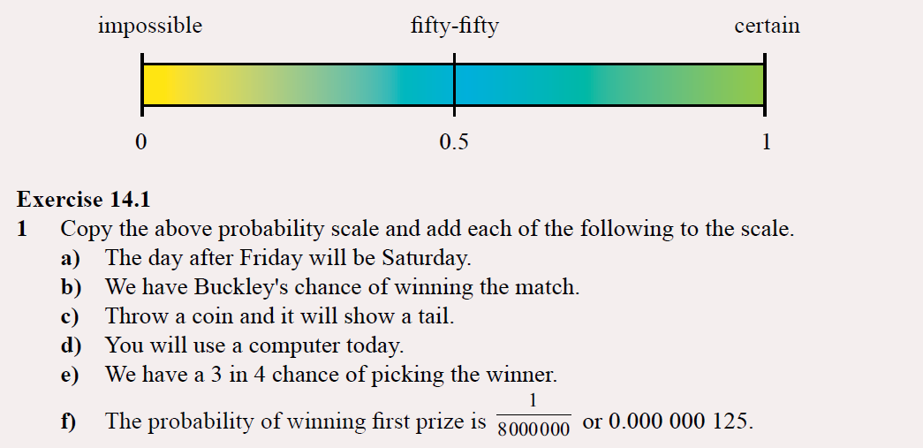
Practice
Notes:
Guide students through the question.
Option 2: Dot plots handout (Scaffolded for kids who may need extra help)

Slide 6
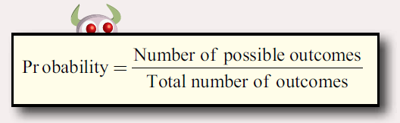
24
7
30
Topic: Probability
Date:
EQ – What have we learnt about probability so far?
How to calculate probability?

Slide 7
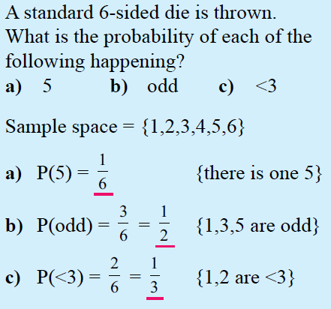
24
7
30
Topic: Probability
Date:
EQ – What have we learnt about probability so far?
Sample space: A list of all the possible outcomes.
How to calculate probability?

Slide 8
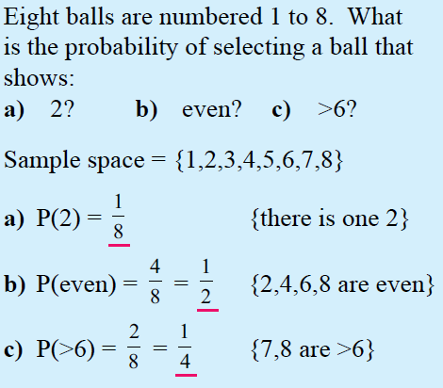
24
7
30
Topic: Probability
Date:
EQ – What have we learnt about probability so far?
Sample space: A list of all the possible outcomes.
How to calculate probability?

Slide 9
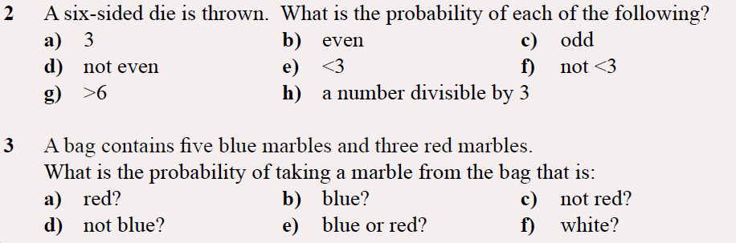
Task
Notes:
Guide students through the question.
Option 2: Dot plots handout (Scaffolded for kids who may need extra help)

